Slide 1


Open Technology Workshops
Open
Street Map

Slide 2
Open Technology Workshops
APPLICATIONS
Open Street Map

Slide 3
Open Technology Workshops
What is OSM?
Google Maps | Open Street Map
A proprietary dataset, application, and navigation suite. | An open-source dataset of map data. Apps by 3rd parties use the dataset for free.
Map data is purchased or collected by Google. | Map data is crowdsourced, like Wikipedia.
Used to deliver advertisements and track users in real space. | OSM does not track users.
It’s all Google. | Vibrant ecosystem of integrations, apps, and related services.
API costs money. | API is free.
Notes:
Open source means that the source code is available to the public and has usually has a permissive license for use. This contrasts with closed source software that has a restrictive license and the source code is not available.
Sources:
https://www.turing.com/blog/open-source-vs-commercial-software-license/#:~:text=Users
%20of%20open%20source%20software,to%20users%20without%20upfront%20costs.
https://www.geeksforgeeks.org/difference-between-open-source-software-and-commercial-software/#

Slide 4
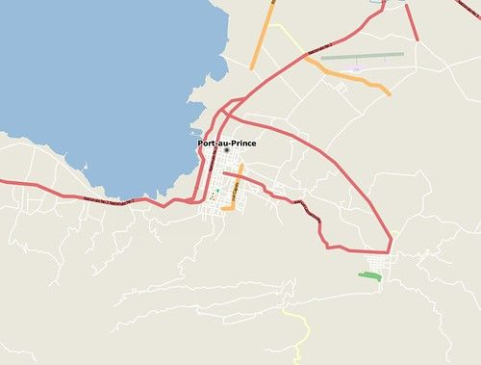
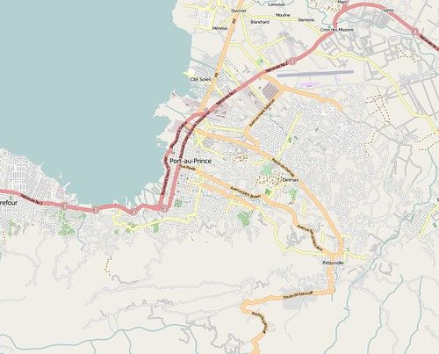
Open Technology Workshops
Humanitarian Efforts
In the aftermath of the massive earthquake that struck Haiti in 2010, mappers made numerous contributions to aide recovery and humanitarian efforts.
https://wiki.openstreetmap.org/wiki/Humanitarian_OSM_Team
https://www.youtube.com/@hotosm
Get involved
https://wiki.openstreetmap.org/wiki/Missing_Maps_mapathons
https://mapgive.state.gov/index.html
Notes:
Open source means that the source code is available to the public and has usually has a permissive license for use. This contrasts with closed source software that has a restrictive license and the source code is not available.
Sources:
https://www.turing.com/blog/open-source-vs-commercial-software-license/#:~:text=Users
%20of%20open%20source%20software,to%20users%20without%20upfront%20costs.
https://www.geeksforgeeks.org/difference-between-open-source-software-and-commercial-software/#

Slide 5
Open Technology Workshops
Education
Tutorials on making contributions
Learning OSM - https://learnosm.org/en/
A nice tutorial video - https://www.youtube.com/watch?v=tojADNJD9Ps
DEMO!!!
Two-minute Tutorials - https://www.youtube.com/playlist?list=PLb9506_-6FMHZ3nwn9heri3xjQKrSq1hN
TeachOSM Meetup Group - https://www.meetup.com/teachosm/
You can use various editors with OSM
iD is the easy-to-use built-in editor. Includes a walkthrough (highly recommended).
JOSM is a standalone Java desktop app
which allows for more advanced editing.
Rapid – An open-source fork of iD developed by Facebook.
Potlatch – A Windows/Mac desktop app based on iD.
Notes:
Open source means that the source code is available to the public and has usually has a permissive license for use. This contrasts with closed source software that has a restrictive license and the source code is not available.
Sources:
https://www.turing.com/blog/open-source-vs-commercial-software-license/#:~:text=Users
%20of%20open%20source%20software,to%20users%20without%20upfront%20costs.
https://www.geeksforgeeks.org/difference-between-open-source-software-and-commercial-software/#

Slide 6
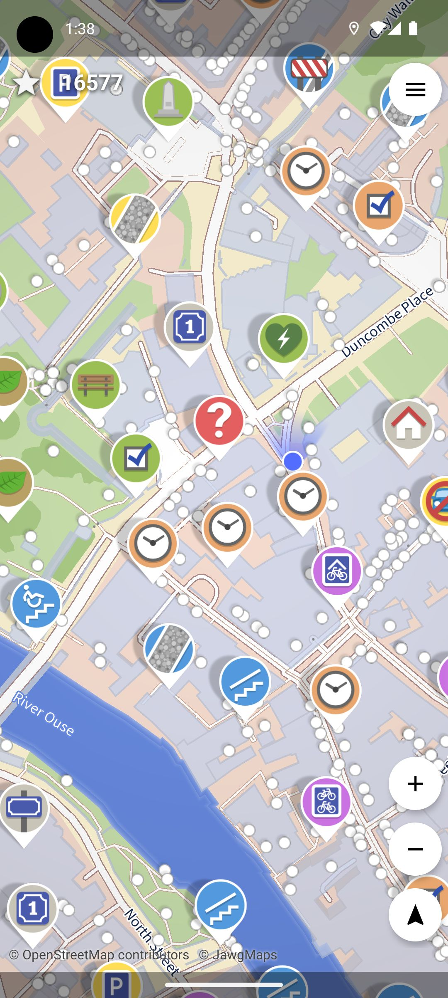
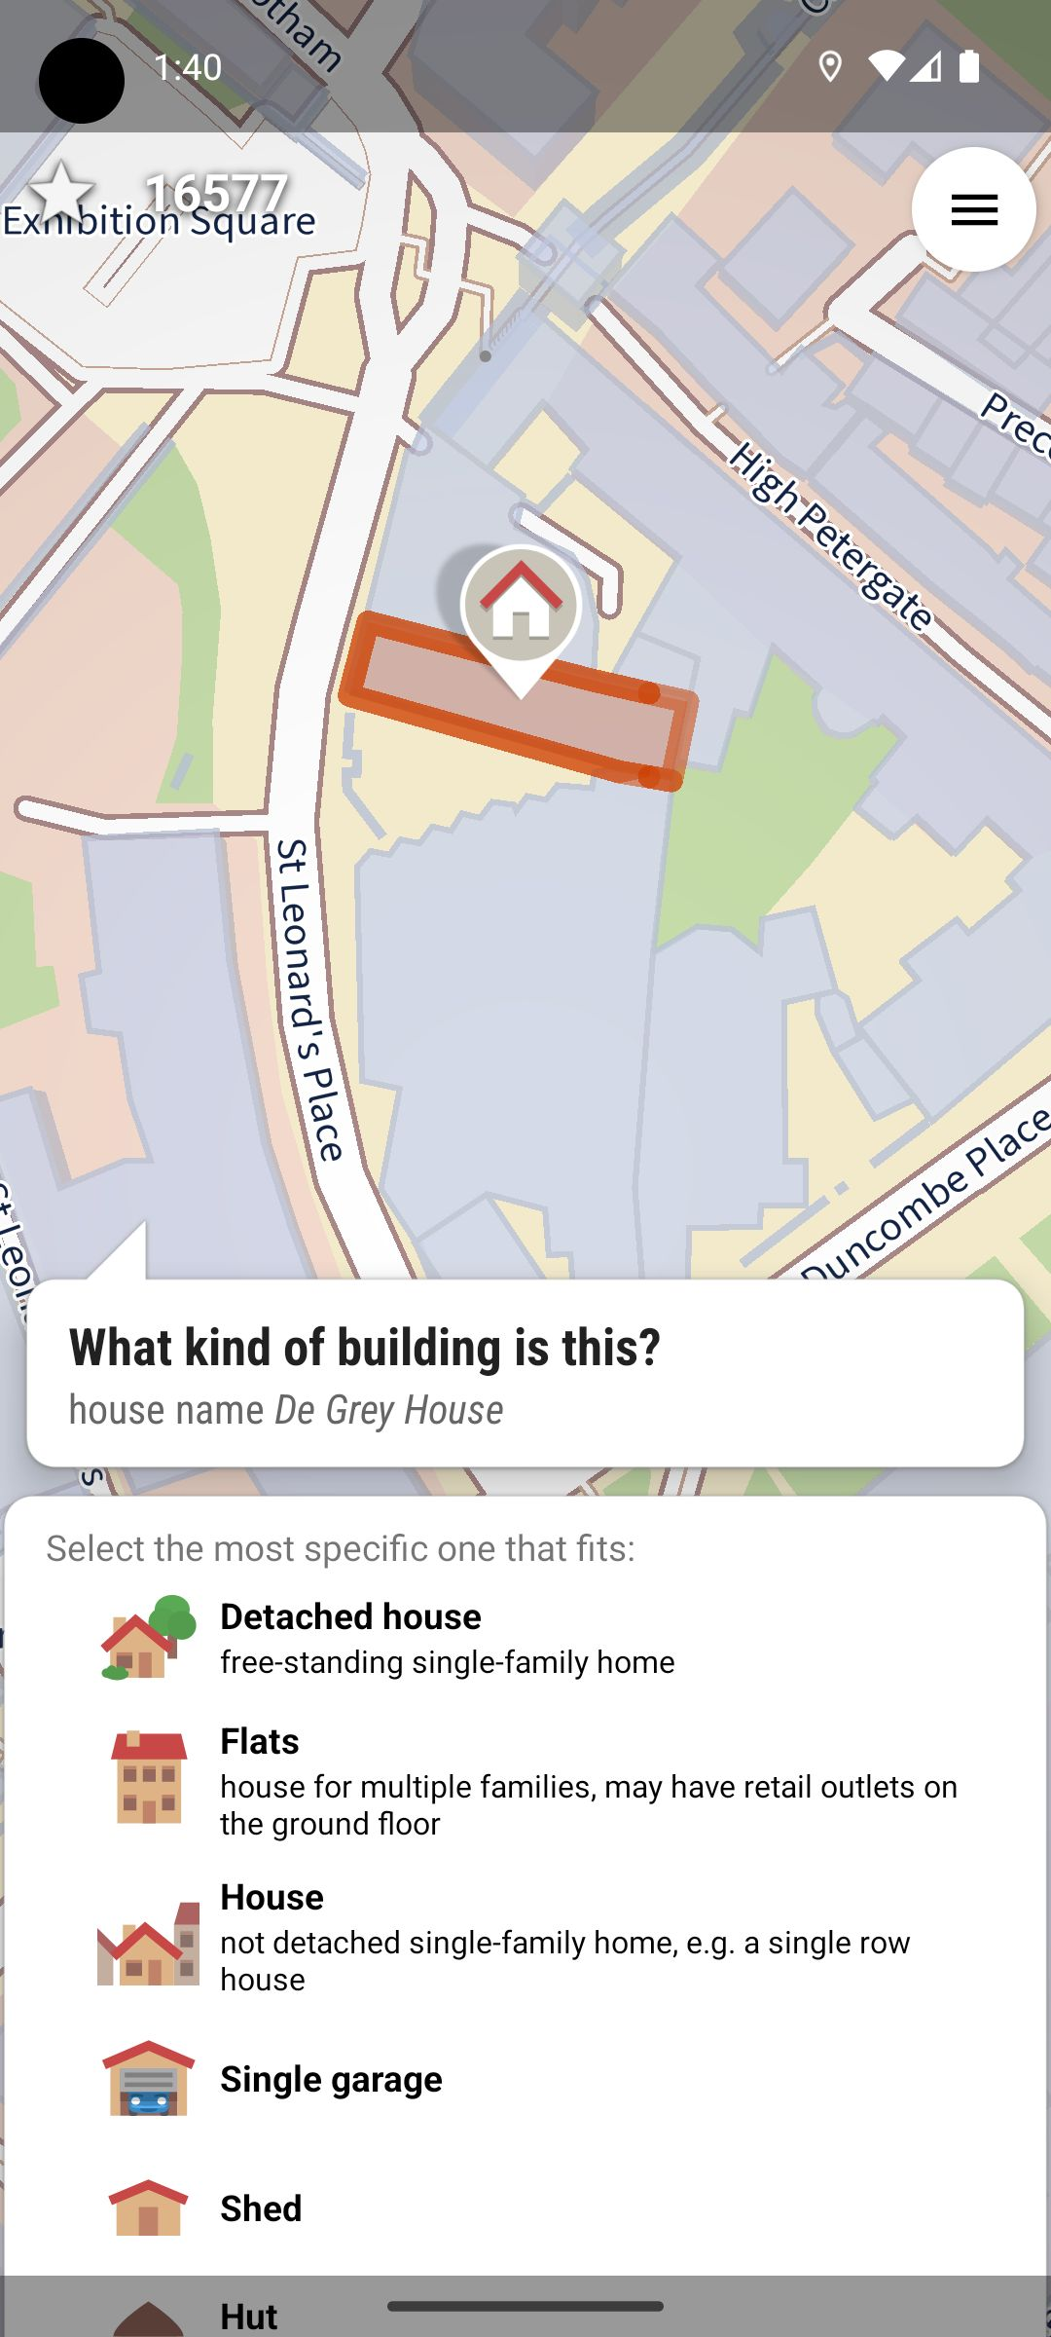





Open Technology Workshops
Street Complete
Try these other mobile editors
Android iOS
Both Android and iOS
DEMO
Vespucci
Osm Go!
Go Map!!
StreetComplete
Every Door
Notes:
Open source means that the source code is available to the public and has usually has a permissive license for use. This contrasts with closed source software that has a restrictive license and the source code is not available.
Sources:
https://www.turing.com/blog/open-source-vs-commercial-software-license/#:~:text=Users
%20of%20open%20source%20software,to%20users%20without%20upfront%20costs.
https://www.geeksforgeeks.org/difference-between-open-source-software-and-commercial-software/#

Slide 7
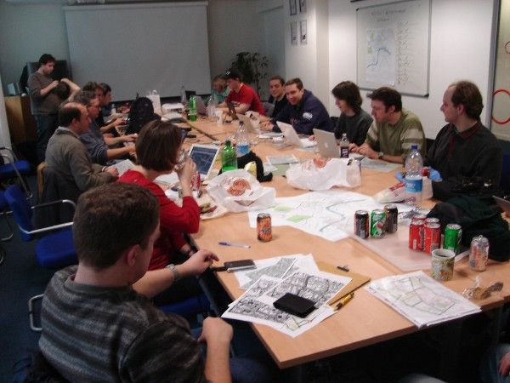

Open Technology Workshops
Mapping Parties
Mapping parties can take place out in the field or inside.
https://wiki.openstreetmap.org/wiki/Mapping_parties
https://wiki.openstreetmap.org/wiki/Mapping_Weekend_Howto
https://wiki.openstreetmap.org/wiki/Mapping_Party_Template
Example objective:
To add more points-of-interest to the city map
as well as tackle areas that still need mapping.
I really want to go to one!
Notes:
Open source means that the source code is available to the public and has usually has a permissive license for use. This contrasts with closed source software that has a restrictive license and the source code is not available.
Sources:
https://www.turing.com/blog/open-source-vs-commercial-software-license/#:~:text=Users
%20of%20open%20source%20software,to%20users%20without%20upfront%20costs.
https://www.geeksforgeeks.org/difference-between-open-source-software-and-commercial-software/#

Slide 8
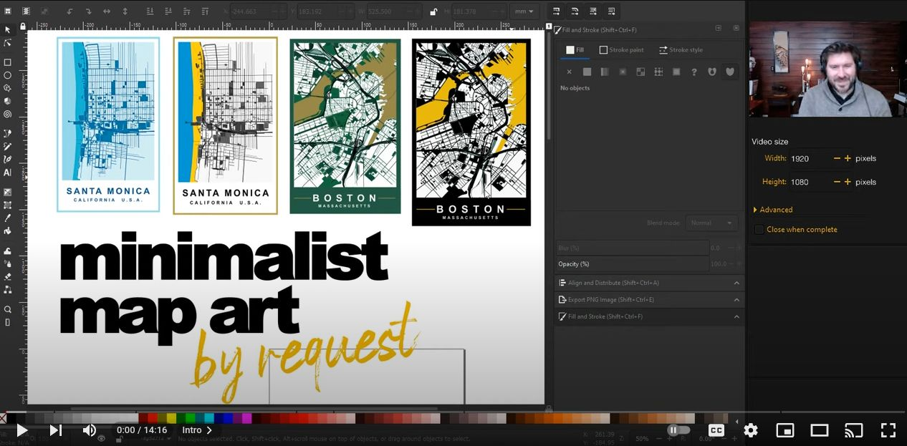
Open Technology Workshops
Artwork
https://www.youtube.com/watch?v=IfFSfn-AAcA
https://www.youtube.com/watch?v=4cL_-X1u6HY
Notes:
Open source means that the source code is available to the public and has usually has a permissive license for use. This contrasts with closed source software that has a restrictive license and the source code is not available.
Sources:
https://www.turing.com/blog/open-source-vs-commercial-software-license/#:~:text=Users
%20of%20open%20source%20software,to%20users%20without%20upfront%20costs.
https://www.geeksforgeeks.org/difference-between-open-source-software-and-commercial-software/#

Slide 9
Open Technology Workshops
Fin
Thank you for coming!

